Slide 1
Topic: EST Preparation
Get your EST tick list. Always have this with you . You will be responsible for filling in notes that you may need for your notes page
EQ: Types of samples?
Census and Surveys investigate the procedure for conducting a census investigate the advantages and disadvantages of conducting a census understand the purpose of sampling to provide an estimate of population values when a census is not used investigate the different kinds of samples, for example, systematic samples, self-selected samples, simple random samples recognise the advantages and disadvantages of these kinds of samples; for example, comparing simple random samples with self-selected samples

Slide 2
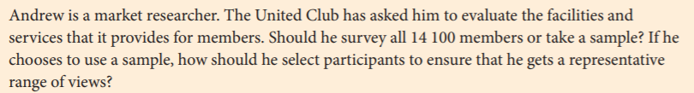
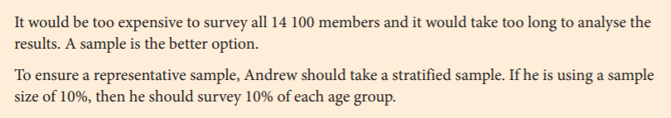
24
7
30
Topic: EST Preparation
Date
EQ: Types of samples?
Warm Up/Teacher example (4 marks):
Crunch and Shoot.
-Work in pairs
- Use butcher’s paper
Let’s discuss why there are 4 marks.
Justify/Explain your reasoning

Slide 3
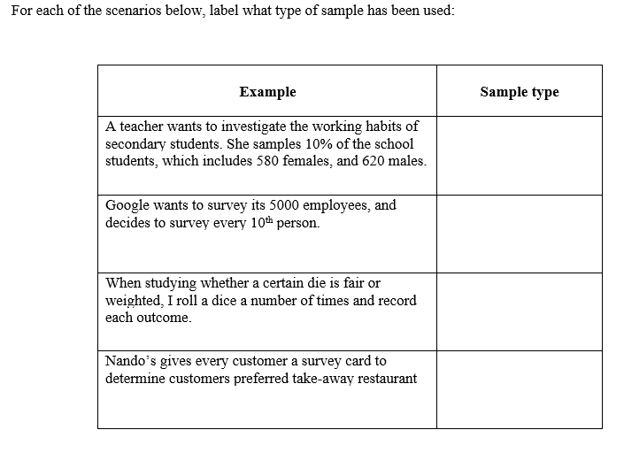
24
7
30
Topic: EST Preparation
Date
EQ: Types of samples?
Round 1: 4 marks
Crunch and Shoot.

Slide 4
24
7
30
Topic: EST Preparation
Date
EQ: Types of samples?
Round 2: 3 marks
Look at the marks to see how much info you need to provide
Crunch and Shoot.
Gilbert decides that he wants to conduct a stratified sample of 30% of the school population.
There are 1265 students at the school, which includes 572 male students and 693 female students.
Calculate how many students he should survey, and how many males and females should be surveyed

Slide 5
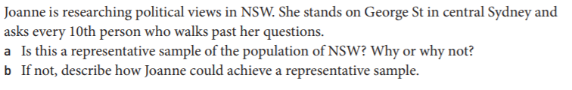
24
7
30
Topic: EST Preparation
Date
EQ: Types of samples?
Round 3: 3 marks
Look at the marks to see how much info you need to provide
Crunch and Shoot.

Slide 6
24
7
30
Topic: EST Preparation
Date
EQ: Types of samples?
Round 4: 3 marks
Crunch and Shoot.
Discuss whether or not the following situation produces a random sample.
SITUATION: Mark is conducting a survey for a magazine. He stops people at random on a Saturday morning at his local shopping centre.

Slide 7
24
7
30
Topic: EST Preparation
Date
EQ: Types of samples?
Round 5: 3 marks
Crunch and Shoot.
-Work in pairs
- Use butcher’s paper
Mr May wants to know the mean IQ of the pupils in his class. Would you recommend that he uses a sample or a census? State which you would use, and explain why.

Slide 8
24
7
30
Topic: EST Preparation
Date
EQ: Types of samples?
Round 6: 2 marks
Crunch and Shoot.
-Work in pairs
- Use butcher’s paper
A theatre group has 40 members of whom 15 are boys. A group of 8 members are to be interviewed to find out their opinion on their latest stage show. Using a stratified sampling technique, how many girls and how many boys should be included in the sample?

Slide 9
24
7
30
Topic: EST Preparation
Date
EQ: Types of samples?
Round 7: 8 marks
Crunch and Shoot.
-Work in pairs
- Use butcher’s paper
There are 1500 homes in one part of a city. These homes can be divided into 3 categories:
- Privately owned homes (720 homes )
- Homes rented from council ( 592 homes)
- Homes rented from private landlords (188 homes)
The council is to carry out a survey into the quality of homes.
What would be the advantage of using a stratified random sample?
b) How many homes of each type should be included in a stratified random sample of size 200 ?

Slide 10
24
7
30
Topic: EST Preparation
Date
EQ: Types of samples?
Solutions:
Round 1: Stratified, systematic, random, self-selected
Round 2: 171-172 males, 207-208 females. So all up between 378- 380 students in total
Round 3:
No. She only surveys people who work in the center of Sydney. She misses country people and people who work elsewhere
A range of answers are acceptable. Focus should be on detail of sampling method in the context
Round 4: To produce a random sample, every member of the population must have an equal chance of being selected. In the case of Mark's sample, he is excluding people who are at work on that Saturday, as well as other people who haven't gone to that shopping centre. So although Mark is stopping people at random, he is not producing a random sample.
Crunch and Shoot.
-Work in pairs
- Use butcher’s paper

Slide 11
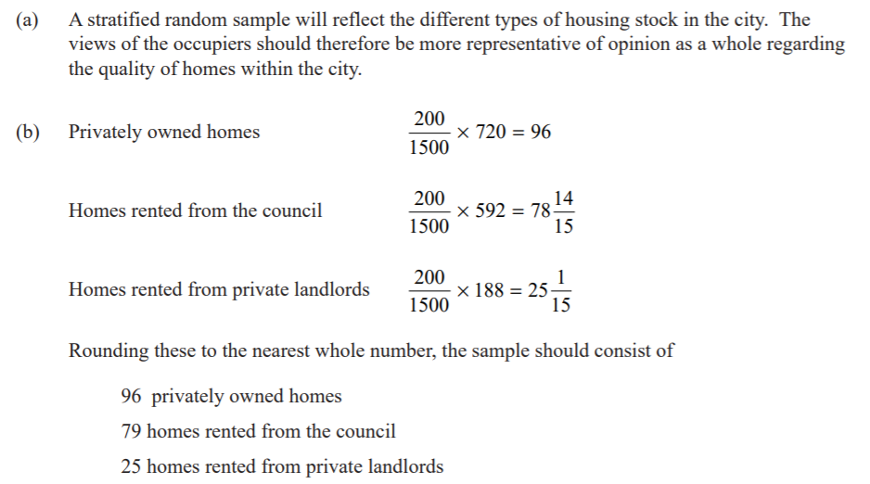
24
7
30
Topic: EST Preparation
Date
EQ: Types of samples?
Solutions:
Round 5: Mr May should use a census. His class is small enough for the data to be found quickly and easily for every pupil in the class. Using a smaller sample may produce a biased value that would not reflect the class as a whole.
Round 6: 5 girls and 3 boys
Round 7:
Crunch and Shoot.
-Work in pairs
- Use butcher’s paper

Slide 12
24
7
30
Topic: EST Preparation
Date
EQ: Types of samples?
Summary time.
-Last 15 mins of lesson you will need to add in any examples/facts/hints you might need to answer similar questions

